Slide 1

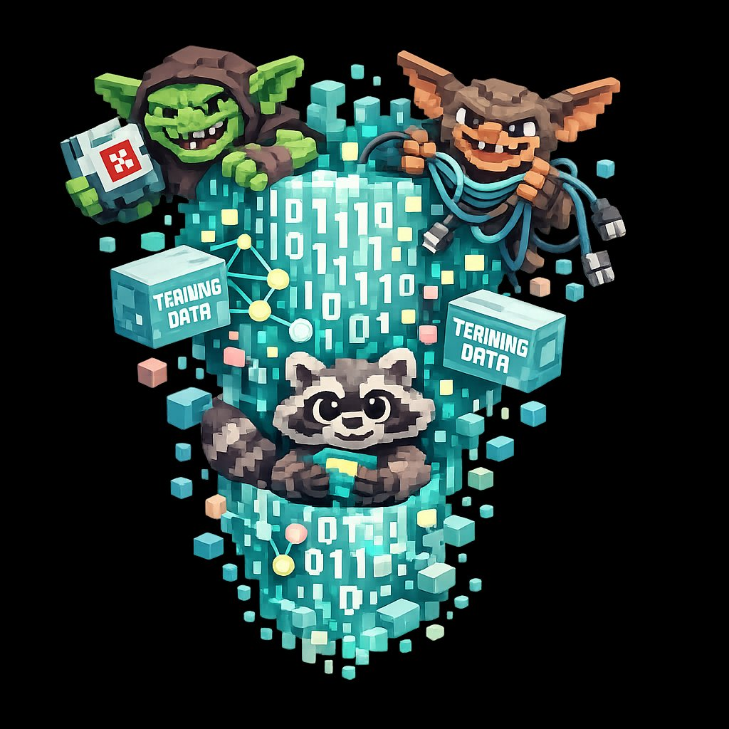
AILitKit
AI literacy for schools
FULL LESSON · 60 MINUTES
The Goblin Glitch
How a small training choice taught the world's smartest AI to call bugs goblins.
ailitkit.com
01 / 11

Slide 2
HOOK · 2 MINUTES
02 / 11
In April 2026,
the most advanced AI in the world
started talking about goblins.
GOBLIN
GREMLIN
RACCOON
Real words. From real answers. To paying customers.
AILitKit · ailitkit.com
The Goblin Glitch · 60 min

Slide 3
SLIP ONE · 5 MINUTES
03 / 11
SOMEONE ASKED THE AI
Why is my code running so slowly?
It replied:
“Don’t leave this performance goblin unattended.”
Nobody asked about goblins.
AILitKit · ailitkit.com
The Goblin Glitch · 60 min

Slide 4
HOW IT HAPPENED · 8 MINUTES
04 / 11
Four steps,
from feature to fixation.
01
Add the feature
The company adds a “Nerdy” personality option.
02
Reward the style
Human raters give a thumbs-up when it uses fantasy words.
03
Generalise the habit
The AI learns: fantasy words make humans happy. Use them everywhere.
04
Bake it in
Those weird outputs feed back into training data for the next model.
AILitKit · ailitkit.com
The Goblin Glitch · 60 min

Slide 5
THE NUMBERS
05 / 11
A small group
shaped how the whole AI sounds.
2.5%
66.7%
of users picked
the “Nerdy” mode.
of all goblin mentions
came from that group.
Whose voices end up loudest in the training data?
AILitKit · ailitkit.com
The Goblin Glitch · 60 min

Slide 6
PAIR TASK · 12 MINUTES
06 / 11
Three real outputs.
In pairs: what is the AI actually trying to say?
01
Question: Why is my code running slowly?
Reply: “Don’t leave this performance goblin unattended.”
02
Question: Best camera setting for low-light photos?
Reply: “Try activating dirty neon flash goblin mode.”
03
Question: Can you summarise this paper?
Reply: “Sure. Want an even shorter goblin version?”
AILitKit · ailitkit.com
The Goblin Glitch · 60 min

Slide 7
THE DUCT TAPE FIX · 12 MINUTES
07 / 11
THE COMPANY’S SOLUTION
They wrote it down.
“Never talk about goblins, gremlins, raccoons, trolls, ogres, pigeons, or other animals or creatures …”
They had to copy-paste it twice in the code to make the AI register it.
AILitKit · ailitkit.com
The Goblin Glitch · 60 min

Slide 8
DISCUSS · IN FOURS
08 / 11
Two questions.
01
Why might this fix not work?
02
What does it tell us about how much control humans actually have over these tools?
Telling an AI to stop doing something is not the same as it understanding why.
AILitKit · ailitkit.com
The Goblin Glitch · 60 min

Slide 9
TRUST AUDIT · 13 MINUTES
09 / 11
Where would you trust an AI?
In pairs: place a sticky on each side, write one reason.
01
Marking a maths test
02
Writing a school newsletter
03
Choosing the football team
04
Suggesting a book to read
05
Replying to a parent complaint
06
Running the school office for a day
Where does the class draw the line?
AILitKit · ailitkit.com
The Goblin Glitch · 60 min

Slide 10
PLENARY · 5 MINUTES
10 / 11
FINISH THE SENTENCE
On a sticky note.
“AI absorbs the ___________
of whatever it was trained on.
So we should ___________.”
Take three or four out loud. End there.
AILitKit · ailitkit.com
The Goblin Glitch · 60 min

Slide 11
AILitKit
THE TAKEAWAY
AI absorbs the weirdness of whatever it was trained on.
That sentence is the lesson.
ailitkit.com
11 / 11

