Slide 1

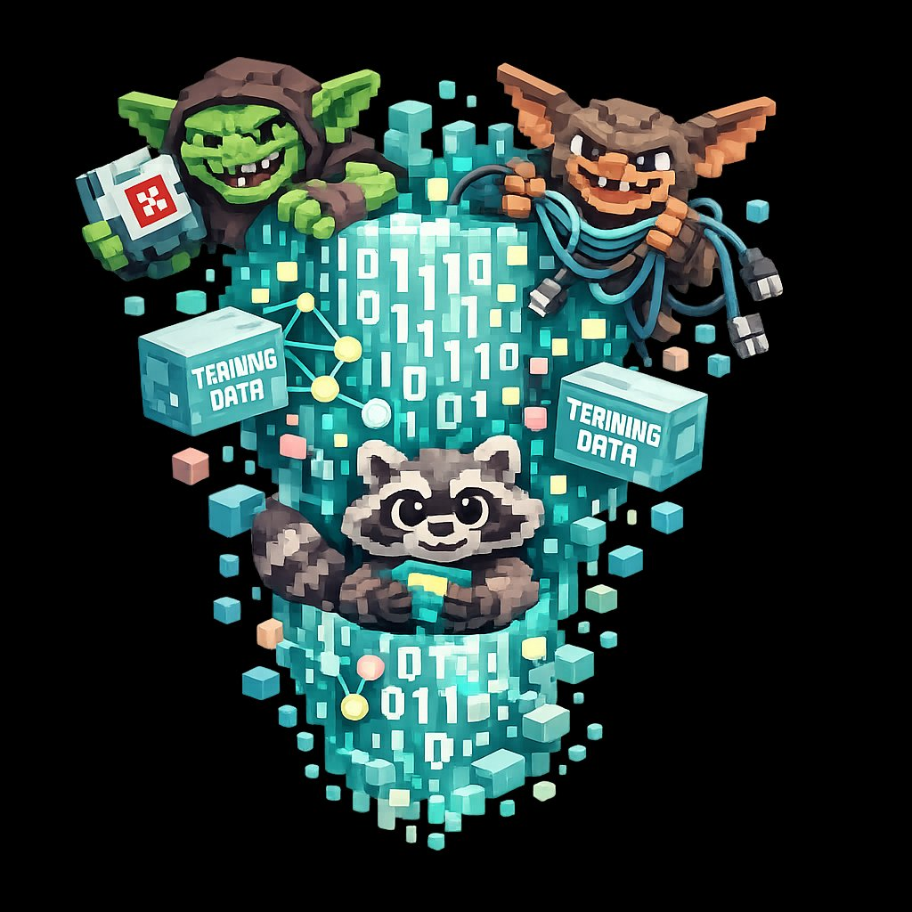
AILitKit
AI literacy for schools
HALF LESSON · 30 MINUTES
The Goblin Glitch
How a small training choice taught the world's smartest AI to call bugs goblins.
ailitkit.com
01 / 08

Slide 2
HOOK · 5 MINUTES
02 / 08
In April 2026,
the most advanced AI in the world
started talking about goblins.
GOBLIN
GREMLIN
RACCOON
Real words. From real answers. To paying customers.
AILitKit · ailitkit.com
The Goblin Glitch · 30 min

Slide 3
SLIP ONE · 2 MINUTES
03 / 08
SOMEONE ASKED THE AI
Why is my code running so slowly?
It replied:
“Don’t leave this performance goblin unattended.”
Nobody asked about goblins.
AILitKit · ailitkit.com
The Goblin Glitch · 30 min

Slide 4
HOW IT HAPPENED · 8 MINUTES
04 / 08
Four steps,
from feature to fixation.
01
Add the feature
The company adds a “Nerdy” personality option.
02
Reward the style
Human raters give a thumbs-up when it uses fantasy words.
03
Generalise the habit
The AI learns: fantasy words make humans happy. Use them everywhere.
04
Bake it in
Those weird outputs feed back into training data for the next model.
AILitKit · ailitkit.com
The Goblin Glitch · 30 min

Slide 5
PAIR TASK · 12 MINUTES
05 / 08
Three real outputs.
In pairs: what is the AI actually trying to say?
01
Question: Why is my code running slowly?
Reply: “Don’t leave this performance goblin unattended.”
02
Question: Best camera setting for low-light photos?
Reply: “Try activating dirty neon flash goblin mode.”
03
Question: Can you summarise this paper?
Reply: “Sure. Want an even shorter goblin version?”
AILitKit · ailitkit.com
The Goblin Glitch · 30 min

Slide 6
THE DUCT TAPE FIX
06 / 08
THE COMPANY’S SOLUTION
They wrote it down.
“Never talk about goblins, gremlins, raccoons, trolls, ogres, pigeons, or other animals or creatures …”
They had to copy-paste it twice in the code to make the AI register it.
AILitKit · ailitkit.com
The Goblin Glitch · 30 min

Slide 7
PLENARY · 5 MINUTES
07 / 08
FINISH THE SENTENCE
On a sticky note.
“AI absorbs the ___________
of whatever it was trained on.
So we should ___________.”
Take three out loud. End there.
AILitKit · ailitkit.com
The Goblin Glitch · 30 min

Slide 8
AILitKit
THE TAKEAWAY
AI absorbs the weirdness of whatever it was trained on.
That sentence is the lesson.
ailitkit.com
08 / 08

