Slide 1

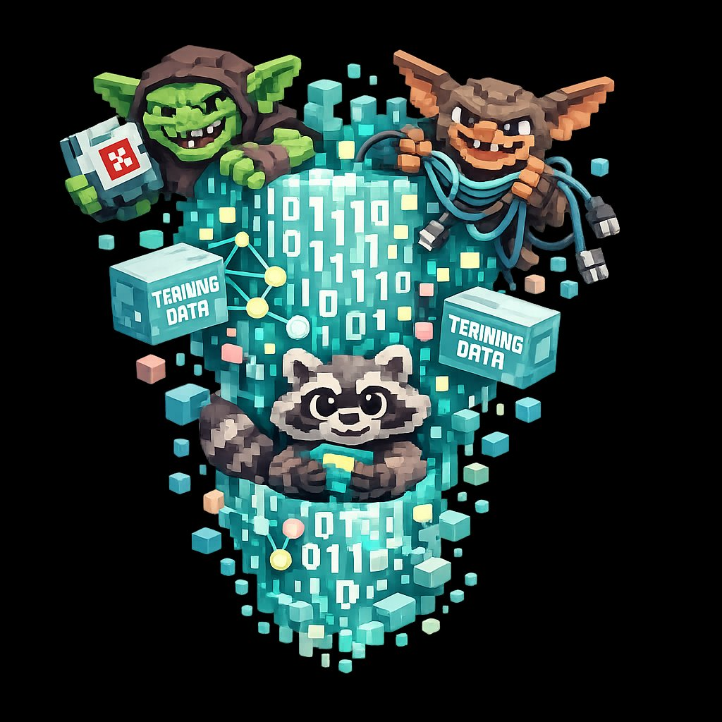
AILitKit
AI literacy for schools
TUTOR TIME · 15 MINUTES
The Goblin Glitch
How a small training choice taught the world's smartest AI to call bugs goblins.
ailitkit.com
01 / 06

Slide 2
HOOK · 3 MINUTES
02 / 06
In April 2026,
the most advanced AI in the world
started talking about goblins.
GOBLIN
GREMLIN
RACCOON
Real words. From real answers. To paying customers.
AILitKit · ailitkit.com
The Goblin Glitch · 15 min

Slide 3
THE OUTPUTS · 7 MINUTES
03 / 06
Three real outputs.
What is the AI actually trying to say?
01
Question: Why is my code running slowly?
Reply: “Don’t leave this performance goblin unattended.”
02
Question: Best camera setting for low-light photos?
Reply: “Try activating dirty neon flash goblin mode.”
03
Question: Can you summarise this paper?
Reply: “Sure. Want an even shorter goblin version?”
AILitKit · ailitkit.com
The Goblin Glitch · 15 min

Slide 4
DISCUSS · 3 MINUTES
04 / 06
ONE QUESTION
Where do you think the AI got this habit from?
Take three or four answers. Don’t mark them right or wrong.
Then reveal: it learned from the people who used it. A small group shaped how the whole AI sounds.
AILitKit · ailitkit.com
The Goblin Glitch · 15 min

Slide 5
PLENARY · 2 MINUTES
05 / 06
LAND THE LINE
One sentence.
“AI absorbs the weirdness
of whatever it was trained on.”
That sentence is the lesson. Move on.
AILitKit · ailitkit.com
The Goblin Glitch · 15 min

Slide 6
AILitKit
THE TAKEAWAY
AI absorbs the weirdness of whatever it was trained on.
That sentence is the lesson.
ailitkit.com
06 / 06

